Slide 1
WQD7010 Network & Security
Dr. Saaidal Razalli Bin Azzuhri
Dept. of Comp. System & Technology
Fac. of Science Comp & IT

Slide 2
Lecture 9
Firewalls

Slide 3
Lecture 9: Learning Objectives
On completion of this session you should:
Understand why firewalls are necessary
Discuss the design goals of firewalls
Discuss what firewalls can do and cannot do
Be familiar with different types of firewalls
Describe the advantages and disadvantages of different types of firewalls
Be familiar with various firewall configurations
Discuss what level of security each configuration offers

Slide 4
Outline
What is a firewall?
Firewall design goals
What firewalls can do
What firewalls can’t do
Types of firewalls
Firewall configurations

Slide 5
Introduction
Information systems have evolved
from centralized data processing system to Inter networked distributed data access and Internet connection
This growth has introduced persistent security concerns, because
it is not practical to equip each workstation and server with intrusion protection
flawless OS and software can’t be guaranteed
networks usually consists of hundreds and thousands of systems running mixed version of software
A firewall can add to the security scheme
erects an outer security wall
provides a single point where security and audit can be imposed
acts as the first line of defense

Slide 6
The Need for firewalls
Internet connectivity is no longer optional for organizations
Individual users within the organization want and need Internet access
While Internet access provides benefits to the organization, it enables the outside world to reach and interact with local network assets
This creates a threat to the organization
While it is possible to equip each workstation and server on the premises network with strong security features, this may not be sufficient and in some cases is not cost-effective
Firewall
An alternative, or at least complement, to host-based security services
Is inserted between the premises network and the Internet to establish a controlled link and to erect an outer security wall or perimeter
The aim of this perimeter is to protect the premises network from Internet-based attacks and to provide a single choke point where security and auditing can be imposed
May be a single computer system or a set of two or more systems that cooperate to perform the firewall function
Notes:
Information systems in corporations, government agencies, and other organizations
have undergone a steady evolution. The following are notable developments:
• Centralized data processing system, with a central mainframe supporting a
number of directly connected terminals
• Local area networks (LANs) interconnecting PCs and terminals to each other
and the mainframe
• Premises network, consisting of a number of LANs, interconnecting PCs,
servers, and perhaps a mainframe or two
• Enterprise-wide network, consisting of multiple, geographically distributed
premises networks interconnected by a private wide area network (WAN)
• Internet connectivity, in which the various premises networks all hook into the
Internet and may or may not also be connected by a private WAN
Internet connectivity is no longer optional for organizations. The information
and services available are essential to the organization. Moreover, individual users
within the organization want and need Internet access, and if this is not provided via
their LAN, they will use dial-up capability from their PC to an Internet service provider
(ISP). However, while Internet access provides benefits to the organization, it
enables the outside world to reach and interact with local network assets. This creates
a threat to the organization. While it is possible to equip each workstation and
server on the premises network with strong security features, such as intrusion protection,
this may not be sufficient and in some cases is not cost-effective. Consider
a network with hundreds or even thousands of systems, running various operating
systems, such as different versions of UNIX and Windows. When a security flaw
is discovered, each potentially affected system must be upgraded to fix that flaw.
This requires scaleable configuration management and aggressive patching to function
effectively. While difficult, this is possible and is necessary if only host-based
security is used. A widely accepted alternative or at least complement to host-based
security services is the firewall. The firewall is inserted between the premises network
and the Internet to establish a controlled link and to erect an outer security
wall or perimeter. The aim of this perimeter is to protect the premises network from
Internet-based attacks and to provide a single choke point where security and auditing
can be imposed. The firewall may be a single computer system or a set of two or
more systems that cooperate to perform the firewall function.
The firewall, then, provides an additional layer of defense, insulating the
internal systems from external networks. This follows the classic military doctrine of
“defense in depth,” which is just as applicable to IT security.

Slide 7
Firewall: Design Goals
Firewalls are based on the following design goals:
all traffic in both direction must pass through the firewall
implemented by physically blocking all accesses to the local network except via the firewall
only authorized traffic, defined by local security policies, will be allowed to pass
firewall itself must be immune to penetration
underpins the use of trusted system with a secure operating system
Notes:
[BELL94] lists the following design goals for a firewall:
1. All traffic from inside to outside, and vice versa, must pass through the firewall.
This is achieved by physically blocking all access to the local network
except via the firewall. Various configurations are possible, as explained later
in this chapter.
2. Only authorized traffic, as defined by the local security policy, will be allowed
to pass. Various types of firewalls are used, which implement various types of
security policies, as explained later in this chapter.
3. The firewall itself is immune to penetration. This implies the use of a hardened
system with a secured operating system. Trusted computer systems are
suitable for hosting a firewall and often required in government applications.
A critical component in the planning and implementation of a firewall is
specifying a suitable access policy. This lists the types of traffic authorized to pass
through the firewall, including address ranges, protocols, applications, and content
types. This policy should be developed from the organization’s information security
risk assessment and policy. This policy should be developed from a broad specification
of which traffic types the organization needs to support. It is then refined to
detail the filter elements we discuss next, which can then be implemented within an
appropriate firewall topology.

Slide 8
Firewall Characteristics
Characteristics that a firewall access policy could use to filter traffic:
IP Address and Protocol Values
Controls access based on the source or destination addresses and port numbers, direction of flow being inbound or outbound, and other network and transport layer characteristics
Application Protocol
Controls access on the basis of authorized application protocol data
User Identity
Controls access based on the user’s identity, typically for inside users who identify themselves using some form of secure authentication technology, such as IPSec
Network Activity
Controls access based on considerations such as the time or request
Notes:
SP 800-41-1 (Guidelines on Firewalls and Firewall Policy , September 2009)
lists a range of characteristics that a firewall access policy could use to filter traffic,
including:
■ IP Address and Protocol Values: Controls access based on the source or
destination addresses and port numbers, direction of flow being inbound or
outbound, and other network and transport layer characteristics. This type of
filtering is used by packet filter and stateful inspection firewalls. It is typically
used to limit access to specific services.
■ Application Protocol: Controls access on the basis of authorized application
protocol data. This type of filtering is used by an application-level gateway
that relays and monitors the exchange of information for specific application
protocols, for example, checking SMTP e-mail for spam, or HTPP Web
requests to authorized sites only.
■ User Identity: Controls access based on the users identity, typically for inside
users who identify themselves using some form of secure authentication technology,
such as IPSec (Chapter 9).
■ Network Activity: Controls access based on considerations such as the time
or request, for example, only in business hours; rate of requests, for example,
to detect scanning attempts; or other activity patterns.

Slide 9
Firewall expectations
A firewall
Defines a single choke point that keeps unauthorized users out of the protected network, prohibits potentially vulnerable services from entering or leaving the network, and provides protection from various kinds of IP spoofing and routing attacks
Provides a location for monitoring
security-related events
Is a convenient platform for several Internet functions that are not security related
Can serve as the platform for IPsec
Notes:
Before proceeding to the details of firewall types and configurations, it is best
to summarize what one can expect from a firewall. The following capabilities are
within the scope of a firewall:
1. A firewall defines a single choke point that keeps unauthorized users out of
the protected network, prohibits potentially vulnerable services from entering
or leaving the network, and provides protection from various kinds of IP
spoofing and routing attacks. The use of a single choke point simplifies security
management because security capabilities are consolidated on a single
system or set of systems.
2. A firewall provides a location for monitoring security-related events. Audits
and alarms can be implemented on the firewall system.
3. A firewall is a convenient platform for several Internet functions that are not
security related. These include a network address translator, which maps local
addresses to Internet addresses, and a network management function that
audits or logs Internet usage.
4. A firewall can serve as the platform for IPsec. Using the tunnel mode capability
described in Chapter 9, the firewall can be used to implement virtual
private networks.

Slide 10
What Firewalls can do?
Manage access between the organization's network (trusted) ←→Internet (untrusted)
without a firewall, security depends on the "hardness" of each host's security features
overall security is only as good as the weakest link
Allow the network administrator to define a centralized"choke point"
offer access control, protection from vulnerable services and routing attacks
simplify security management
Offer a convenient network point where security-related events can be monitored and alarms can be generated
NAT(Network Address Translator) can be deployed at the firewall
Firewall is a convenient point to audit or log Internet usage
Implement VPNs using IPsec
Must be immune to any penetration attack

Slide 11
What Firewalls can do?
There are arguments that the deployment of firewalls creates a single point of failure
It should be emphasized that, just because we have deployed firewalls, security of individual host systems cannot be neglected
Appropriate security policies must also be implemented in individual hosts to ensure security of organization's network

Slide 13
Firewall limitations
Cannot protect against attacks that bypass the firewall
May not protect fully against internal threats, such as a disgruntled employee or an employee who unwittingly cooperates with an external attacker
Cannot guard against wireless communications between local systems on different sides of the internal firewall
A laptop, PDA, or portable storage device may be used and infected outside the corporate network, and then attached and used internally
A Firewall
Notes:
Firewalls have their limitations, including the following:
1. The firewall cannot protect against attacks that bypass the firewall. Internal
systems may have dial-out capability to connect to an ISP. An internal LAN
may support a modem pool that provides dial-in capability for traveling
employees and telecommuters.
2. The firewall may not protect fully against internal threats, such as a disgruntled
employee or an employee who unwittingly cooperates with an external
attacker.
3. An improperly secured wireless LAN may be accessed from outside the
organization. An internal firewall that separates portions of an enterprise
network cannot guard against wireless communications between local
systems on different sides of the internal firewall.
4. A laptop, PDA, or portable storage device may be used and infected outside
the corporate network, and then attached and used internally.

Slide 14
Type of Firewalls
Packet filtering firewall
Stateful inspection firewall
Application proxy firewall
Circuit-level proxy firewall
Some firewall design can be combination of all these types of firewalls

Slide 15
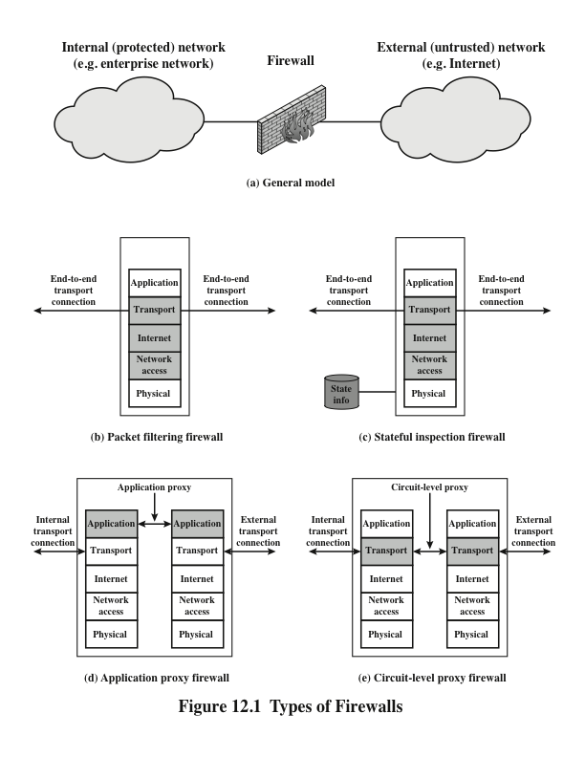
Notes:
A packet filtering firewall applies a set of rules to each incoming and outgoing
IP packet and then forwards or discards the packet (Figure 12.1b). The firewall
is typically configured to filter packets going in both directions (from and to
the internal network). Filtering rules are based on information contained in a
network packet:
• Source IP address: The IP address of the system that originated the IP packet
(e.g., 192.178.1.1)
• Destination IP address: The IP address of the system the IP packet is trying to
reach (e.g., 192.168.1.2)
• Source and destination transport-level address: The transport-level (e.g., TCP
or UDP) port number, which defines applications such as SNMP or TELNET
• IP protocol field: Defines the transport protocol
• Interface: For a firewall with three or more ports, which interface of the
firewall the packet came from or which interface of the firewall the packet is
destined for
The packet filter is typically set up as a list of rules based on matches to fields
in the IP or TCP header. If there is a match to one of the rules, that rule is invoked
to determine whether to forward or discard the packet. If there is no match to any
rule, then a default action is taken. Two default policies are possible:
• Default discard: That which is not expressly permitted is prohibited.
• Default forward: That which is not expressly prohibited is permitted.
The default discard policy is more conservative. Initially, everything is
blocked, and services must be added on a case-by-case basis. This policy is more
visible to users, who are more likely to see the firewall as a hindrance. However,
this is the policy likely to be preferred by businesses and government organizations.
Further, visibility to users diminishes as rules are created. The default forward
policy increases ease of use for end users but provides reduced security; the
security administrator must, in essence, react to each new security threat as it
becomes known. This policy may be used by generally more open organizations,
such as universities.

Slide 16
Packet Filtering Firewall
Apply a SET OF RULES to each incoming IP packet and then either forwards or discards the packet
Filter packets going in BOTH DIRECTIONS
The packet filter is typically set up as a list of rules based on matches to fields in the IP or TCP header
source IP address
destination IP address
source and destination TCP or UDP port number
type of the protocol (IP, TCP, UDP or ICMP)
Message type (SYN, ACK, FIN, RST)

Slide 17
Packet Filtering Firewall
Two default policies (discard or forward)
Discard: traffic expressly not permitted is prohibited → more conservative
Forward: traffic expressly not prohibited is permitted → hence reduced security
Allow all packets going to specific TCP ports while rest of the packets are dropped
e.g., Web (port 80), DNS (port 53), and SMTP (port 25) be allowed
Do not allow any packets from external network with a source IP address of the internal network
provides anti-spoofing protection

Slide 18
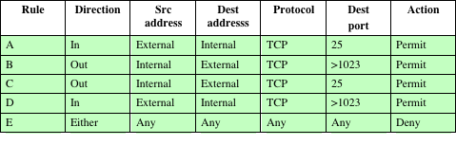
Packet Filtering Firewall: Examples (Table 12.1)
Table 12.1 is a simplified example of a ruleset for SMTP traffic. The goal is to allow inbound and outbound e-mail traffic but to block all other traffic. The rules are applied top to bottom to each packet.
A. Inbound mail from an external source is allowed (port 25 is for SMTP incoming).
B. This rule is intended to allow a response to an inbound SMTP connection.
C. Outbound mail to an external source is allowed.
D. This rule is intended to allow a response from an outbound SMTP connection.
E. This is an explicit statement of the default policy. All rulesets include this rule implicitly as the last rule.
Notes:
Table 12.1 is a simplified example of a ruleset for SMTP traffic. The goal is to
allow inbound and outbound e-mail traffic but to block all other traffic. The rules
are applied top to bottom to each packet.
A. Inbound mail from an external source is allowed (port 25 is for SMTP
incoming).
B. This rule is intended to allow a response to an inbound SMTP connection.
C. Outbound mail to an external source is allowed.
D. This rule is intended to allow a response to an inbound SMTP connection.
E. This is an explicit statement of the default policy. All rulesets include this rule
implicitly as the last rule.

Slide 19
Packet Filtering firewalls
Weaknesses
Its simplicity
Transparent to users and are very fast
Because packet filter firewalls do not examine upper-layer data, they cannot prevent attacks that employ application-specific vulnerabilities or functions
Because of the limited information available to the firewall, the logging functionality present in packet filter firewalls is limited
Most packet filter firewalls do not support advanced user authentication schemes
Packet filter firewalls are generally vulnerable to attacks and exploits that take advantage of problems within the TCP/IP specification and protocol stack
Due to the small number of variables used in access control decisions, packet filter firewalls are susceptible to security breaches caused by improper configurations
Strengths
Notes:
One advantage of a packet filtering firewall is its simplicity. Also, packet
filters typically are transparent to users and are very fast. [SCAR09b] lists the
following weaknesses of packet filter firewalls:
• Because packet filter firewalls do not examine upper-layer data, they cannot
prevent attacks that employ application-specific vulnerabilities or functions.
For example, a packet filter firewall cannot block specific application
commands; if a packet filter firewall allows a given application, all functions
available within that application will be permitted.
• Because of the limited information available to the firewall, the logging functionality
present in packet filter firewalls is limited. Packet filter logs normally
contain the same information used to make access control decisions (source
address, destination address, and traffic type).
• Most packet filter firewalls do not support advanced user authentication
schemes. Once again, this limitation is mostly due to the lack of upper-layer
functionality by the firewall.
• Packet filter firewalls are generally vulnerable to attacks and exploits that take
advantage of problems within the TCP/IP specification and protocol stack,
such as network layer address spoofing . Many packet filter firewalls cannot
detect a network packet in which the OSI Layer 3 addressing information has
been altered. Spoofing attacks are generally employed by intruders to bypass
the security controls implemented in a firewall platform.
• Finally, due to the small number of variables used in access control decisions,
packet filter firewalls are susceptible to security breaches caused by improper
configurations. In other words, it is easy to accidentally configure a packet
filter firewall to allow traffic types, sources, and destinations that should be
denied based on an organization’s information security policy.

Slide 20
Attacks and countermeasures
IP address spoofing
The intruder transmits packets from the outside with a source IP address field containing an address of an internal host
Countermeasure is to discard packets with an inside source address if the packet arrives on an external interface
Source routing attacks
The source station specifies the route that a packet should take as it crosses the internet, in the hopes that this will bypass security measures that do not analyze the source routing information
Countermeasure is to discard all packets that use this option
Tiny fragment attacks
The intruder uses the IP fragmentation option to create extremely small fragments and force the TCP header information into a separate packet fragment
Countermeasure is to enforce a rule that the first fragment of a packet must contain a predefined minimum amount of the transport header
Notes:
Some of the attacks that can be made on packet filtering firewalls and the appropriate
countermeasures are the following:
• IP address spoofing: The intruder transmits packets from the outside with a
source IP address field containing an address of an internal host. The attacker
hopes that the use of a spoofed address will allow penetration of systems that
employ simple source address security, in which packets from specific trusted
internal hosts are accepted. The countermeasure is to discard packets with an
inside source address if the packet arrives on an external interface. In fact, this
countermeasure is often implemented at the router external to the firewall.
• Source routing attacks: The source station specifies the route that a packet
should take as it crosses the Internet, in the hopes that this will bypass security
measures that do not analyze the source routing information. The countermeasure
is to discard all packets that use this option.
• Tiny fragment attacks: The intruder uses the IP fragmentation option to create
extremely small fragments and force the TCP header information into a
separate packet fragment. This attack is designed to circumvent filtering rules
that depend on TCP header information. Typically, a packet filter will make a
filtering decision on the first fragment of a packet. All subsequent fragments
of that packet are filtered out solely on the basis that they are part of the
packet whose first fragment was rejected. The attacker hopes that the filtering
firewall examines only the first fragment and that the remaining fragments
are passed through. A tiny fragment attack can be defeated by enforcing a
rule that the first fragment of a packet must contain a predefined minimum
amount of the transport header. If the first fragment is rejected, the filter can
remember the packet and discard all subsequent fragments.

Slide 21
Firewalls – Stateful Packet Filters
Traditional packet filters do not examine transport layer context
ie matching return packets with outgoing flow
Stateful packet filters address this need
They examine each IP packet in context
Keep track of client-server sessions
Check each packet validly belongs to one
Hence are better able to detect bogus packets out of context
Notes:
A traditional packet filter makes filtering decisions on an individual packet basis and does not take into consideration any higher layer context. A stateful inspection packet filter tightens up the rules for TCP traffic by creating a directory of outbound TCP connections, and will allow incoming traffic to high-numbered ports only for those packets that fit the profile of one of the entries in this directory. Hence they are better able to detect bogus packets sent out of context.

Slide 22
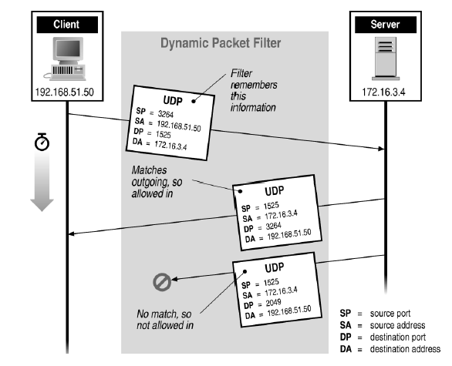
Stateful Filtering
Notes:
Now can you look at this figure and tell me why the first response is allowed while the 2nd not?

Slide 23
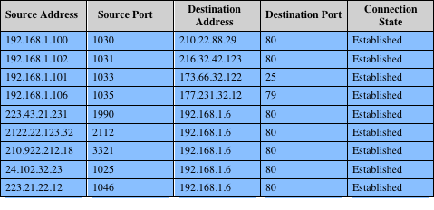
Table 12.2
Example Stateful Firewall Connection State Table
A stateful inspection packet firewall tightens up the rules for TCP traffic by creating a directory of outbound TCP connections, as shown in Table 12.2. There is an entry for each currently established connection. The packet filter will now allow incoming traffic to high-numbered ports only for those packets that fit the profile of one of the entries in this directory.
Some stateful firewalls also keep track of TCP sequence numbers to prevent attacks that depend on the sequence number, such as session hijacking.
Some even inspect limited amounts of application data for some well-known protocols like FTP, IM and SIPS commands, in order to identify and track related connections.
Notes:
A stateful inspection packet firewall tightens up the rules for TCP traffic by
creating a directory of outbound TCP connections, as shown in Table 12.2. There is
an entry for each currently established connection. The packet filter will now allow
incoming traffic to high-numbered ports only for those packets that fit the profile of
one of the entries in this directory.
A stateful packet inspection firewall reviews the same packet information
as a packet filtering firewall, but also records information about TCP connections
(Figure 12.1c). Some stateful firewalls also keep track of TCP sequence numbers
to prevent attacks that depend on the sequence number, such as session hijacking.
Some even inspect limited amounts of application data for some well-known
protocols like FTP, IM and SIPS commands, in order to identify and track related
connections.

Slide 24
Firewall Gateways
Firewall runs set of proxy programs
Proxies filter incoming, outgoing packets
All incoming traffic directed to firewall
All outgoing traffic appears to come from firewall
Policy embedded in proxy programs
Two kinds of proxies
Application-level gateways/proxies
Tailored to http, ftp, smtp, etc.
Circuit-level gateways/proxies
Working on TCP level
Notes:
Gateway is like a NAT box, ie, a home router.

Slide 25
Application Level Gateway
Also called an application proxy
Acts as a relay of application-level traffic
If the gateway does not implement the proxy code for a specific application, the service is not supported and cannot be forwarded across the firewall
The gateway can be configured to support only specific features of an application that the network administrator considers acceptable while denying all other features
Tend to be more secure than packet filters
Disadvantage:
The additional processing overhead on each connection
Notes:
An application-level gateway, also called an application proxy , acts as a relay of
application-level traffic (Figure 12.1d). The user contacts the gateway using a TCP/
IP application, such as Telnet or FTP, and the gateway asks the user for the name
of the remote host to be accessed. When the user responds and provides a valid
user ID and authentication information, the gateway contacts the application on
the remote host and relays TCP segments containing the application data between
the two endpoints. If the gateway does not implement the proxy code for a specific
application, the service is not supported and cannot be forwarded across the firewall.
Further, the gateway can be configured to support only specific features of an
application that the network administrator considers acceptable while denying all
other features.
Application-level gateways tend to be more secure than packet filters. Rather
than trying to deal with the numerous possible combinations that are to be allowed
and forbidden at the TCP and IP level, the application-level gateway need only
scrutinize a few allowable applications. In addition, it is easy to log and audit all
incoming traffic at the application level.
A prime disadvantage of this type of gateway is the additional processing
overhead on each connection. In effect, there are two spliced connections between
the end users, with the gateway at the splice point, and the gateway must examine
and forward all traffic in both directions.

Slide 26
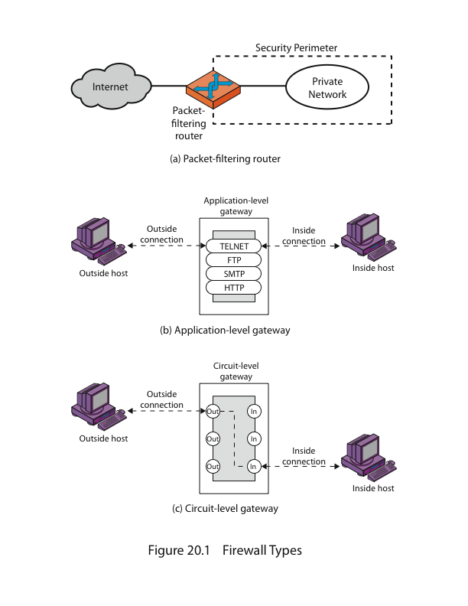
Firewalls - Application Level Gateway (or Proxy)

Slide 27
Application Level Gateway - Operation
A client on the internal network requests access to an application (e.g. web access) on the external network
The request is forwarded to the proxy sever (e.g., HTTP proxy server)
The proxy determines whether the request is valid
checks against the security policies of the organization
Then sends a new request on behalf of the client to the destination
no direct connection from internal to external network
the request appears to have originated from the application gateway/proxy
Any response from the external network is sent back to the application gateway/proxy
proxy determines if it is valid and then sends it on to the client

Slide 28
Application Level Gateway
Advantages:
more secure than packet filters
Only needs to inspect a few allowable applications
do not need to deal with numerous combination of filtering rules
it is easy to log and audit all incoming traffic at the application level
allows the network administrator to have more control over traffic passing through the firewall
application gateways/proxies offer robust user authentication

Slide 29
Application Level Gateway
Disadvantages:
The prime disadvantage is the additional processing overload on each connection
Slower than packet-filtering firewall
Each protocol (HTTP, SMTP, etc.) requires its own gateway/proxy application
if one does not exist, then the corresponding protocol will not be allowed through the firewall
Typically requires additional client configuration
Proxy can be a single point of failure
since all requests are channeled through the proxy server
Implementation costs can be high
may require the purchase of additional hardware, software, expertise, or support

Slide 30
Circuit-Level Gateway
Also called circuit-level proxy
Can be a stand-alone system or it can be a specialized function performed by an application-level gateway for certain applications
Does not permit an end-to-end TCP connection
The security function consists of determining which connections will be allowed
Typical use is a situation in which the system administrator trusts the internal users
Can be configured to support application-level or proxy service on inbound connections and circuit-level functions for outbound connections
Example of implementation is the SOCKS package (RFC1928)
Notes:
A fourth type of firewall is the circuit-level gateway or circuit-level proxy
(Figure 12.1e). This can be a stand-alone system or it can be a specialized function
performed by an application-level gateway for certain applications. As with
an application gateway, a circuit-level gateway does not permit an end-to-end TCP
connection; rather, the gateway sets up two TCP connections, one between itself
and a TCP user on an inner host and one between itself and a TCP user on an outside
host. Once the two connections are established, the gateway typically relays
TCP segments from one connection to the other without examining the contents.
The security function consists of determining which connections will be allowed.
A typical use of circuit-level gateways is a situation in which the system administrator
trusts the internal users. The gateway can be configured to support
application-level or proxy service on inbound connections and circuit-level functions
for outbound connections. In this configuration, the gateway can incur the processing
overhead of examining incoming application data for forbidden functions
but does not incur that overhead on outgoing data.
An example of a circuit-level gateway implementation is the SOCKS package
[KOBL92]; version 5 of SOCKS is specified in RFC 1928. The RFC defines SOCKS
in the following fashion:
The protocol described here is designed to provide a framework for
client-server applications in both the TCP and UDP domains to conveniently
and securely use the services of a network firewall. The
protocol is conceptually a “shim-layer” between the application layer
and the transport layer, and as such does not provide network-
layer gateway services, such as forwarding of ICMP messages.
SOCKS consists of the following components:
• The SOCKS server, which often runs on a UNIX-based firewall. SOCKS is
also implemented on Windows systems.
• The SOCKS client library, which runs on internal hosts protected by the firewall.
• SOCKS-ified versions of several standard client programs such as FTP and
TELNET. The implementation of the SOCKS protocol typically involves
either the recompilation or relinking of TCP-based client applications or the
use of alternate dynamically loaded libraries, to use the appropriate encapsulation
routines in the SOCKS library.
When a TCP-based client wishes to establish a connection to an object that is
reachable only via a firewall (such determination is left up to the implementation),
it must open a TCP connection to the appropriate SOCKS port on the SOCKS
server system. The SOCKS service is located on TCP port 1080. If the connection
request succeeds, the client enters a negotiation for the authentication method to
be used, authenticates with the chosen method, and then sends a relay request. The
SOCKS server evaluates the request and either establishes the appropriate connection
or denies it. UDP exchanges are handled in a similar fashion. In essence, a TCP
connection is opened to authenticate a user to send and receive UDP segments, and
the UDP segments are forwarded as long as the TCP connection is open.

Slide 31
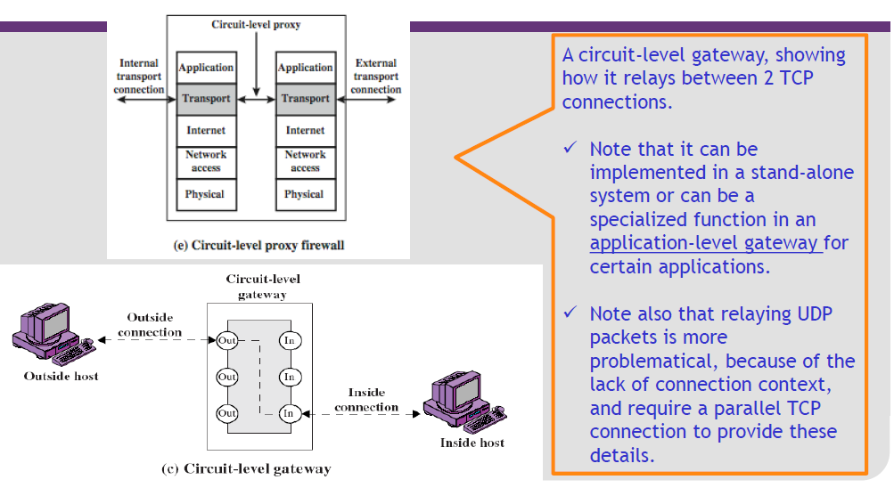
Circuit-Level Gateway (cont..)

Slide 32
Bastion Host
A system identified by the firewall administrator as a critical strong point in the network’s security
Typically serves as a platform for an application-level or circuit-level gateway
Common characteristics:
Executes a secure version of its operating system, making it a hardened system
Only the services that the network administrator considers essential are installed
May require additional authentication before a user is allowed access to the proxy services
Each proxy is configured to support only a subset of the standard application’s command set
Each proxy is configured to allow access only to specific host systems
Each proxy maintains detailed audit information by logging all traffic, each connection, and the duration of each connection
Each proxy module is a very small software package specifically designed for network security
Each proxy is independent of other proxies on the bastion host
A proxy generally performs no disk access other than to read its initial configuration file
Each proxy runs as a nonprivileged user in a private and secured directory on the bastion host
Notes:
A bastion host is a system identified by the firewall administrator as a critical strong
point in the network’s security. Typically, the bastion host serves as a platform for
an application-level or circuit-level gateway. Common characteristics of a bastion
host are as follows:
• The bastion host hardware platform executes a secure version of its operating
system, making it a hardened system.
• Only the services that the network administrator considers essential are
installed on the bastion host. These could include proxy applications for DNS,
FTP, HTTP, and SMTP.
• The bastion host may require additional authentication before a user is
allowed access to the proxy services. In addition, each proxy service may
require its own authentication before granting user access.
• Each proxy is configured to support only a subset of the standard application’s
command set.
• Each proxy is configured to allow access only to specific host systems. This
means that the limited command/feature set may be applied only to a subset
of systems on the protected network.
• Each proxy maintains detailed audit information by logging all traffic, each
connection, and the duration of each connection. The audit log is an essential
tool for discovering and terminating intruder attacks.
• Each proxy module is a very small software package specifically designed for
network security. Because of its relative simplicity, it is easier to check such
modules for security flaws. For example, a typical UNIX mail application may
contain over 20,000 lines of code, while a mail proxy may contain fewer than 1000.
• Each proxy is independent of other proxies on the bastion host. If there is a
problem with the operation of any proxy, or if a future vulnerability is discovered,
it can be uninstalled without affecting the operation of the other proxy
applications. Also, if the user population requires support for a new service, the
network administrator can easily install the required proxy on the bastion host.
• A proxy generally performs no disk access other than to read its initial configuration
file. Hence, the portions of the file system containing executable code
can be made read only. This makes it difficult for an intruder to install Trojan
horse sniffers or other dangerous files on the bastion host.
• Each proxy runs as a nonprivileged user in a private and secured directory on
the bastion host.

Slide 33
Host-Based Firewall
A software module used to secure an individual host
Is available in many operating systems or can be provided as an add-on package
Filters and restricts the flow of packets
Common location is a server
Advantages:
Filtering rules can be tailored to the host environment
Protection is provided independent of topology
Used in conjunction with stand-alone firewalls, provides an additional layer of protection
Notes:
A host-based firewall is a software module used to secure an individual host. Such
modules are available in many operating systems or can be provided as an add-on
package. Like conventional stand-alone firewalls, host-resident firewalls filter and
restrict the flow of packets. A common location for such firewalls is a server. There
are several advantages to the use of a server-based or workstation-based firewall:
• Filtering rules can be tailored to the host environment. Specific corporate security
policies for servers can be implemented, with different filters for servers
used for different application.
• Protection is provided independent of topology. Thus both internal and external
attacks must pass through the firewall.
• Used in conjunction with stand-alone firewalls, the host-based firewall provides
an additional layer of protection. A new type of server can be added to
the network, with its own firewall, without the necessity of altering the network
firewall configuration.

Slide 34
Personal Firewall
Controls the traffic between a personal computer or workstation on one side and the Internet or enterprise network on the other side
Can be used in the home environment and on corporate intranets
Typically is a software module on the personal computer
Can also be housed in a router that connects all of the home computers to a DSL, cable modem, or other Internet interface
Primary role is to deny unauthorized remote access to the computer
Can also monitor outgoing activity in an attempt to detect and block worms and other malware
Notes:
A personal firewall controls the traffic between a personal computer or workstation
on one side and the Internet or enterprise network on the other side. Personal firewall
functionality can be used in the home environment and on corporate intranets.
Typically, the personal firewall is a software module on the personal computer. In
a home environment with multiple computers connected to the Internet, firewall
functionality can also be housed in a router that connects all of the home computers
to a DSL, cable modem, or other Internet interface.
Personal firewalls are typically much less complex than either server-based
firewalls or stand-alone firewalls. The primary role of the personal firewall is to
deny unauthorized remote access to the computer. The firewall can also monitor
outgoing activity in an attempt to detect and block worms and other malware.

Slide 35
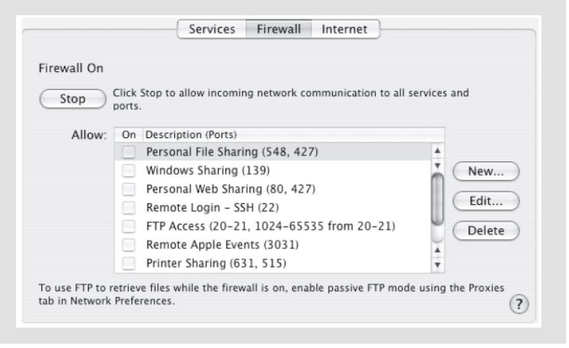
Personal Firewall

Slide 36
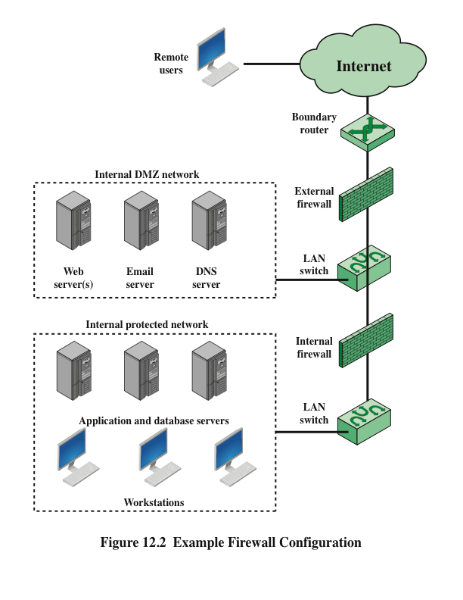
Notes:
Figure 12.2 suggests the most common distinction, that between an internal and an
external firewall. An external firewall is placed at the edge of a local or enterprise
network, just inside the boundary router that connects to the Internet or some wide
area network (WAN). One or more internal firewalls protect the bulk of the enterprise
network. Between these two types of firewalls are one or more networked
devices in a region referred to as a DMZ (demilitarized zone) network. Systems
that are externally accessible but need some protections are usually located on
DMZ networks. Typically, the systems in the DMZ require or foster external connectivity,
such as a corporate Web site, an e-mail server, or a DNS (domain name
system) server.
The external firewall provides a measure of access control and protection for
the DMZ systems consistent with their need for external connectivity. The external
firewall also provides a basic level of protection for the remainder of the enterprise
network. In this type of configuration, internal firewalls serve three purposes:
1. The internal firewall adds more stringent filtering capability, compared to the
external firewall, in order to protect enterprise servers and workstations from
external attack.
2. The internal firewall provides two-way protection with respect to the DMZ.
First, the internal firewall protects the remainder of the network from attacks
launched from DMZ systems. Such attacks might originate from worms, rootkits,
bots, or other malware lodged in a DMZ system. Second, an internal firewall
can protect the DMZ systems from attack from the internal protected
network.
3. Multiple internal firewalls can be used to protect portions of the internal network
from each other. For example, firewalls can be configured so that internal
servers are protected from internal workstations and vice versa. A common
practice is to place the DMZ on a different network interface on the external
firewall from that used to access the internal networks.

Slide 37
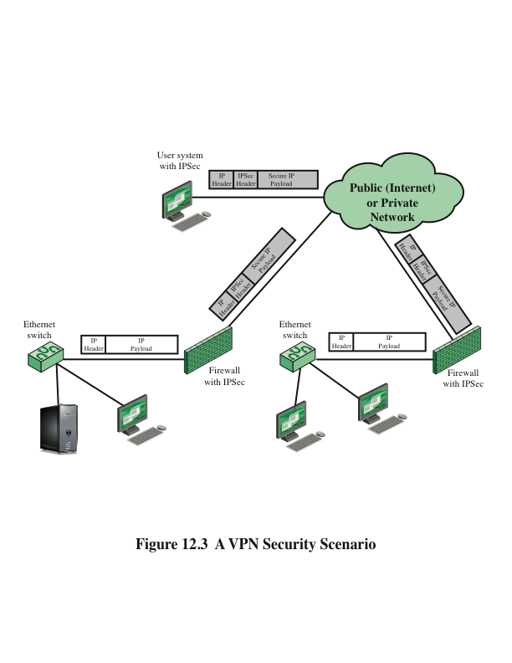
Notes:
In today’s distributed computing environment, the virtual private network (VPN)
offers an attractive solution to network managers. In essence, a VPN consists of
a set of computers that interconnect by means of a relatively unsecure network
and that make use of encryption and special protocols to provide security. At each
corporate site, workstations, servers, and databases are linked by one or more local
area networks (LANs). The Internet or some other public network can be used to
interconnect sites, providing a cost savings over the use of a private network and
offloading the wide area network management task to the public network provider.
That same public network provides an access path for telecommuters and other
mobile employees to log on to corporate systems from remote sites.
But the manager faces a fundamental requirement: security. Use of a public
network exposes corporate traffic to eavesdropping and provides an entry point for
unauthorized users. To counter this problem, a VPN is needed. In essence, a VPN
uses encryption and authentication in the lower protocol layers to provide a secure
connection through an otherwise insecure network, typically the Internet. VPNs are
generally cheaper than real private networks using private lines but rely on having
the same encryption and authentication system at both ends. The encryption may
be performed by firewall software or possibly by routers. The most common protocol
mechanism used for this purpose is at the IP level and is known as IPsec.
Figure 12.3 (Compare Figure 9.1) is a typical scenario of IPSec usage. An
organization maintains LANs at dispersed locations. Nonsecure IP traffic is conducted
on each LAN. For traffic off site, through some sort of private or public
WAN, IPSec protocols are used. These protocols operate in networking devices,
such as a router or firewall, that connect each LAN to the outside world. The IPSec
networking device will typically encrypt and compress all traffic going into the
WAN and decrypt and uncompress traffic coming from the WAN; authentication
may also be provided. These operations are transparent to workstations and servers
on the LAN. Secure transmission is also possible with individual users who dial into
the WAN. Such user workstations must implement the IPSec protocols to provide
security. They must also implement high levels of host security, as they are directly
connected to the wider Internet. This makes them an attractive target for attackers
attempting to access the corporate network.
A logical means of implementing an IPSec is in a firewall, as shown in
Figure 12.3. If IPSec is implemented in a separate box behind (internal to) the firewall,
then VPN traffic passing through the firewall in both directions is encrypted.
In this case, the firewall is unable to perform its filtering function or other security
functions, such as access control, logging, or scanning for viruses. IPSec could be
implemented in the boundary router, outside the firewall. However, this device is
likely to be less secure than the firewall and thus less desirable as an IPSec platform.

Slide 38
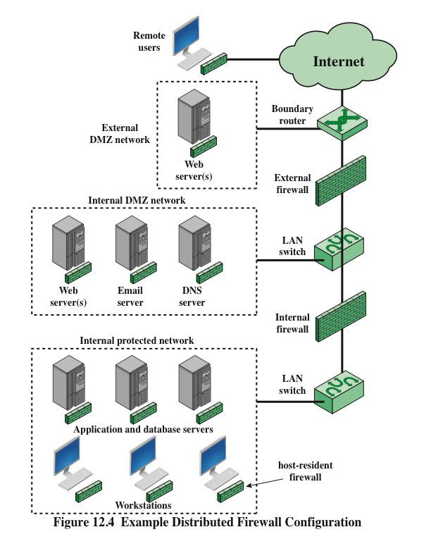
Notes:
A distributed firewall configuration involves stand-alone firewall devices plus
host-based firewalls working together under a central administrative control.
Figure 12.4 suggests a distributed firewall configuration. Administrators can configure
host-resident firewalls on hundreds of servers and workstations as well as
configure personal firewalls on local and remote user systems. Tools let the network
administrator set policies and monitor security across the entire network. These
firewalls protect against internal attacks and provide protection tailored to specific
machines and applications. Stand-alone firewalls provide global protection, including
internal firewalls and an external firewall, as discussed previously.
With distributed firewalls, it may make sense to establish both an internal
and an external DMZ. Web servers that need less protection because they have
less critical information on them could be placed in an external DMZ, outside the
external firewall. What protection is needed is provided by host-based firewalls on
these servers.
An important aspect of a distributed firewall configuration is security
monitoring. Such monitoring typically includes log aggregation and analysis, firewall
statistics, and fine-grained remote monitoring of individual hosts if needed.

Slide 39
Summary of Firewall Locations and Topologies
Host-resident firewall
This category includes personal firewall software and firewall software on servers
Can be used alone or as part of an in-depth firewall deployment
Screening router
A single router between internal and external networks with stateless or full packet filtering
This arrangement is typical for small office/home office (SOHO) applications
Single bastion inline
A single firewall device between an internal and external router
This is the typical firewall appliance configuration for small-to-medium sized organizations
Single bastion T
Similar to single bastion inline but has a third network interface on bastion to a DMZ where externally visible servers are placed
Double bastion inline
DMZ is sandwiched between bastion firewalls
Double bastion T
DMZ is on a separate network interface on the bastion firewall
Distributed firewall configuration
Used by some large businesses and government organizations
Notes:
We can now summarize the discussion from Sections 12.4 and 12.5 to define a spectrum
of firewall locations and topologies. The following alternatives can be identified:
• Host-resident firewall: This category includes personal firewall software and
firewall software on servers. Such firewalls can be used alone or as part of an
in-depth firewall deployment.
• Screening router: A single router between internal and external networks with
stateless or full packet filtering. This arrangement is typical for small office/
home office (SOHO) applications.
• Single bastion inline: A single firewall device between an internal and external
router (e.g., Figure 12.1a). The firewall may implement stateful filters and/
or application proxies. This is the typical firewall appliance configuration for
small- to medium-sized organizations.
• Single bastion T: Similar to single bastion inline but has a third network interface
on bastion to a DMZ where externally visible servers are placed. Again,
this is a common appliance configuration for medium to large organizations.
• Double bastion inline: Figure 12.2 illustrates this configuration, where the
DMZ is sandwiched between bastion firewalls. This configuration is common
for large businesses and government organizations.
• Double bastion T: The DMZ is on a separate network interface on the bastion
firewall. This configuration is also common for large businesses and government
organizations and may be required. For example, this configuration is
required for Australian government use (Australian Government Information
Technology Security Manual—ACSI33).
• Distributed firewall configuration: Illustrated in Figure 12.4. This configuration
is used by some large businesses and government organizations.

Slide 40
Summary
Firewall basing
Bastion host
Host based firewalls
Personal firewall
Firewall locations and configurations
DMZ networks
Virtual private networks
Distributed firewalls
Firewall location and topologies summary
The need for firewalls
Firewall characteristics and access policy
Types of firewalls
Packet filtering firewall
Stateful inspection firewalls
Application level gateway
Circuit level gateway
Notes:
Chapter 12 summary.

